Slide 1
Case study And Assignments
Presented By NithyaShree S
TOP MENTOR

Slide 2
Agenda
Introduction
Problem Statement and Datasourse
Objective And Methodology
Solution Discription And Impact
TOP MENTOR

Slide 3
INTRODUCTION
Casestudy1
A man took a shop in BTM layout ,Bangalore,as a
Local shop,
1.In first 3 months he makes a profit of around 100000,with sales 300000,
2.In the 1st month he was selling veg food ,but he stopped after 2nd month as it stock was not getting out.
3.After 4-5 months down the line the man is making a huge loss in his investment.He has a due of 2 months to pay rent.
4.Sales was not going good and his thinking to close shop and its our job to find the solution to his problem.
TOP MENTOR

Slide 4
Objective
1.To attract the customers to his shop
2.To make the better sales in order to overcome the loss occurred during the past few months.
Methodology
1.He must be much enthusiastic as he was in the beginning,
Since, he already knew the strategy to attract the customers he need to enhance himself in a better way and he should think logically .
2.He should stop bringing the more stock to the shop more than he require.
3.He analysed that non veg sales are going good he should make more varieties of non veg food so that sales will happen good.
4.He should try to convince his owner to reduce the rent to some extent.
5.He should reduce the cost on other expences like current,employee fee and so on…..
TOP MENTOR

Slide 5
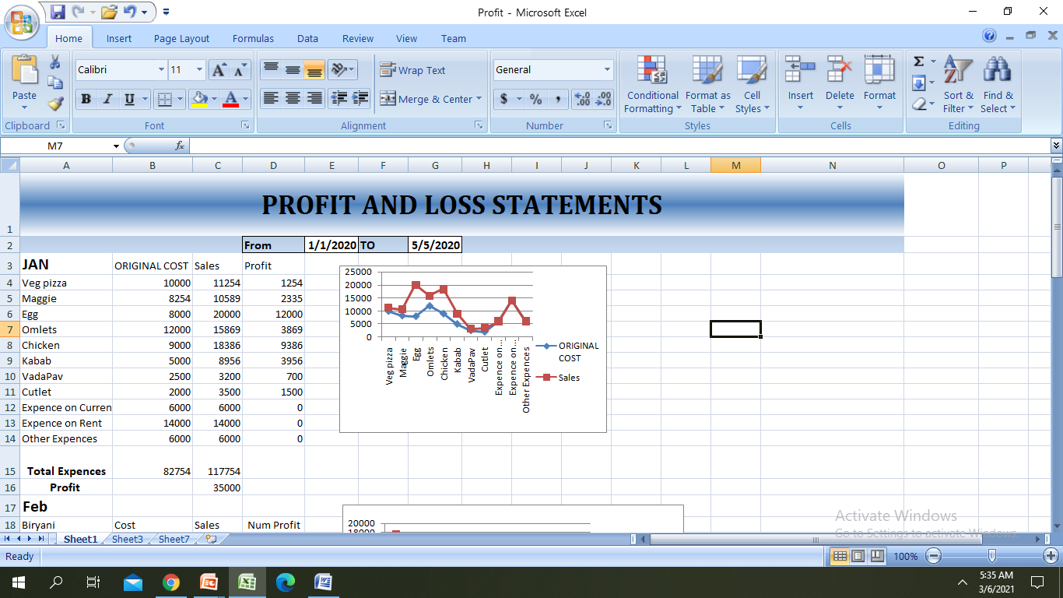
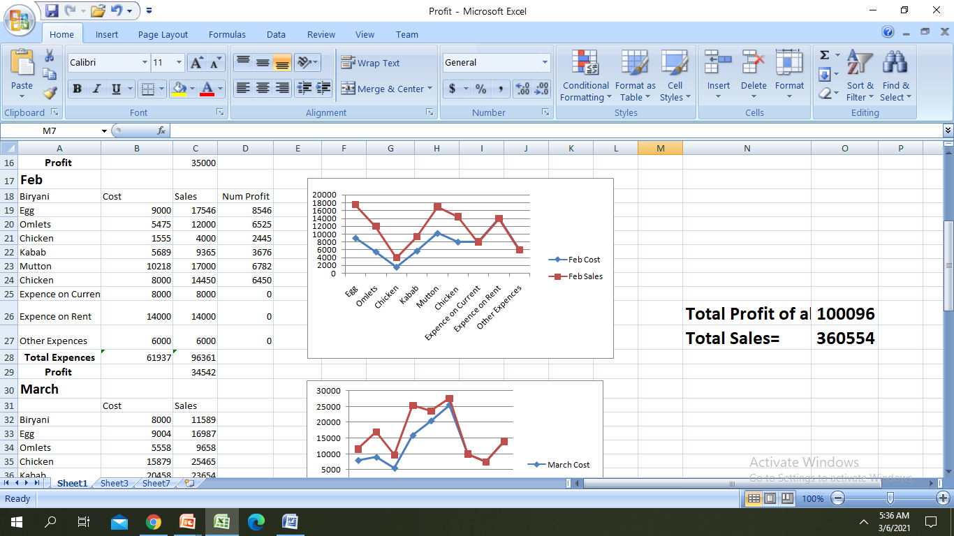
Solution Description
TOP MENTOR

Slide 6
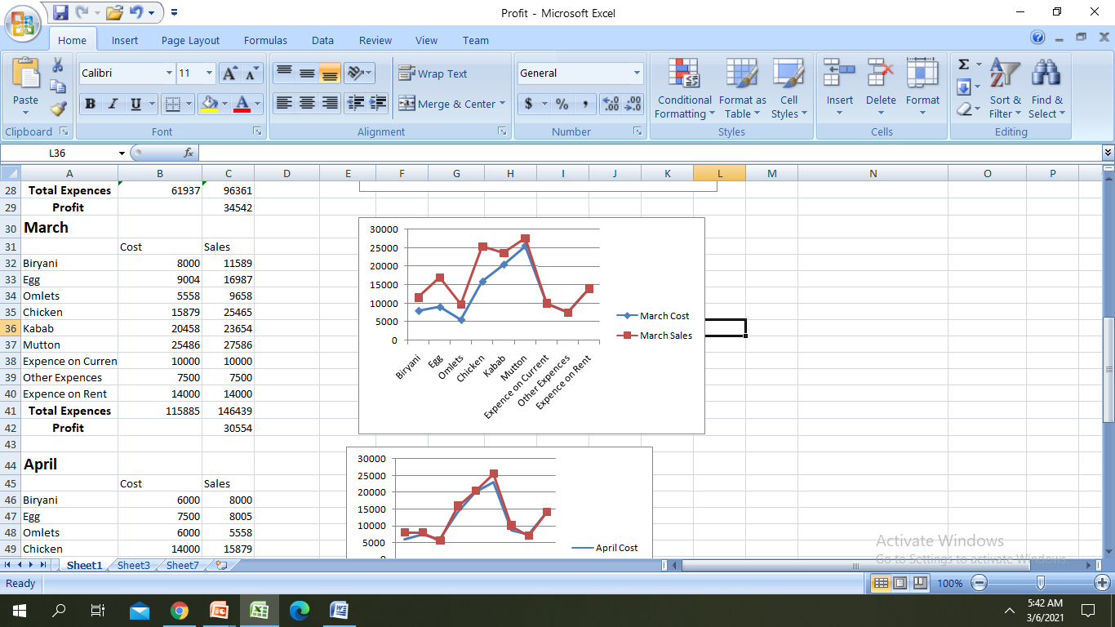
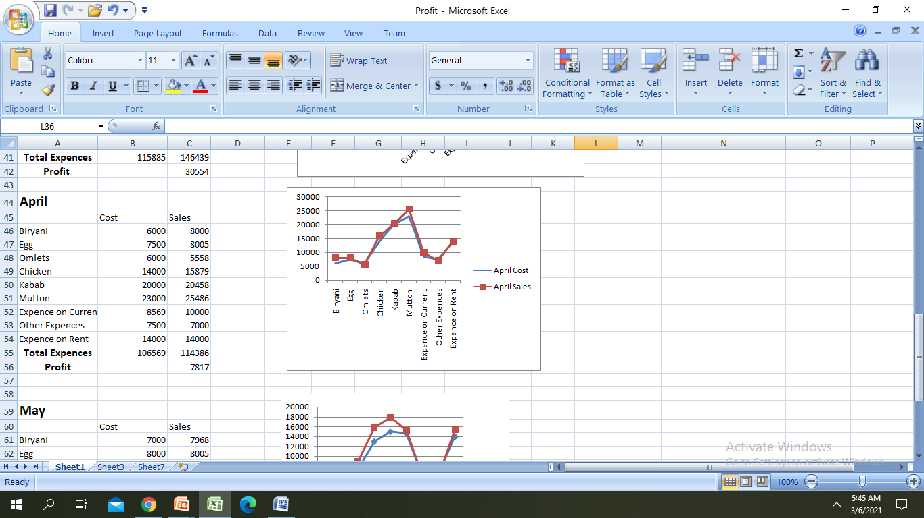
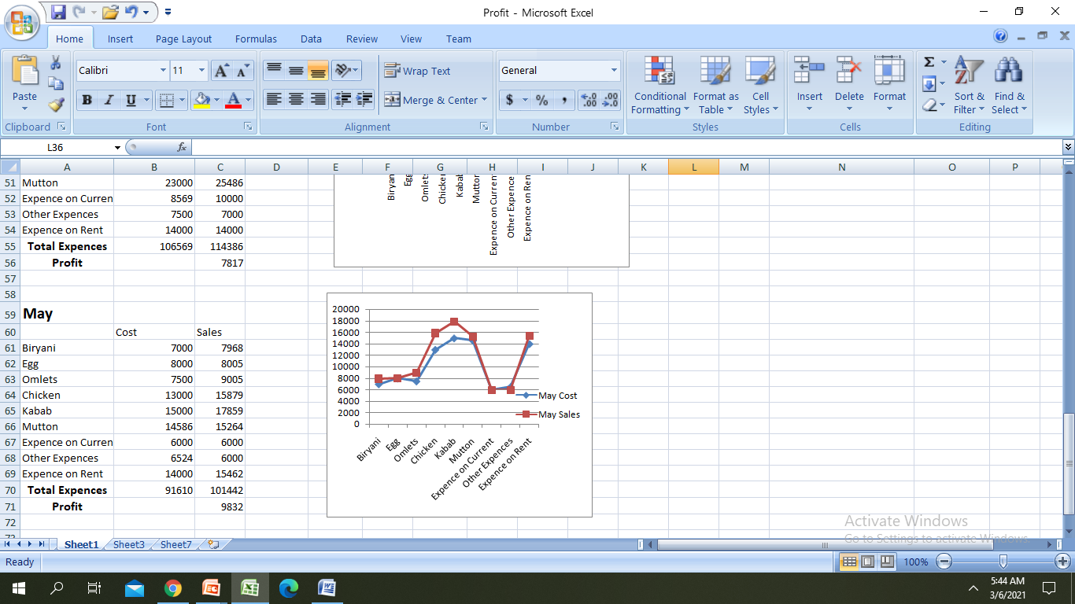
Solution Description And Impact

Slide 7
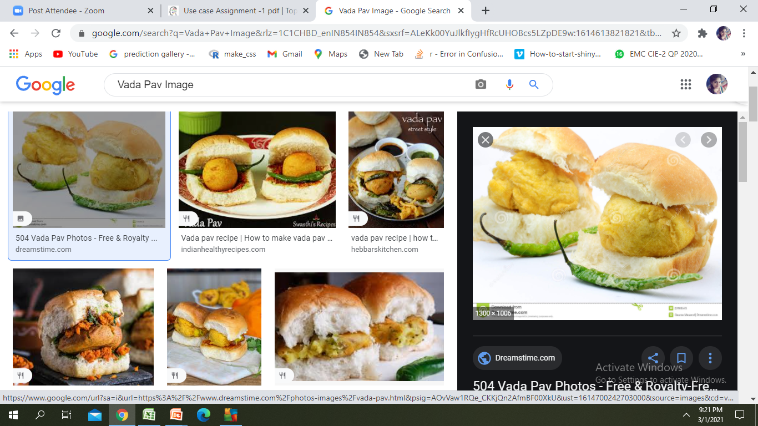
CaseStudy 2 Problem Statement
A man wants to open a Wada Pav shop near Shivajinagar ,Pune.He is not able to Understand what will be the strategy to take over his clients.
a.What will be the price of each Wada Pav?
b.How Will he differentiate from the copetition?
c.why will be the customer comes to your shop?
d. how his ideas changes him to make much profit than others
TOP MENTOR

Slide 8
He must be Dedicated and willingness to sacrifice his time
DESIGN AND METHODOLOGY
Initially he should visit the other shops near by BTM Layout to understand how they work,He should have a friend who can refer many
YES
Offers to be given initially along with verity of food items, maintaining quality and quantity of food
Record keeping and analysis
Friendliness with the customers and better Service with proper hygiene
YES
Having a college or any office is a added advantage
Getting Often feedback from customers
Yes
Profit
NO
TOP MENTOR

Slide 9

TOP MENTOR

